Slide 1
National Quality Improvement Center on the Representation of Children in the Child Welfare System
CHILD LEGAL REPRESENTATION IN AMERICA
NACC National Conference - Chicago
August 16, 2012

Slide 2
OUTLINE
QIC Background and Mission. State of Child Rep Today
Resources Available NOW for practice and policy.
QIC Best Practice Model
Research Design - GA and WA; Three Part Intervention: - QIC Model; Training; Pod support
Training – (Six Core Skills of QIC Model)
THE VISION THING – Looking ahead.

Slide 3
Project Team
U.S. Children’s Bureau
David P. Kelly, FPO
Michigan Law School Chapin Hall Don Duquette Britany Orlebeke Frank Vandervort Andrew Zinn
Robbin Gonzalez Ada Skyles Xiaomeng Zhou
Georgia Washington State
Pat Buonodono Tim Jaasko-Fisher*
Melissa Carter* Rob Wyman
Araceli Jacobs
Jane Okrasinski

Slide 4
1. QIC BACKGROUND & MISSION

Slide 5
Quick!! What’s a QIC?
US Children’s Bureau
Five QICs in 2001
Decentralize Responsibility for Knowledge Development
Promote evidence-based practices
Disseminate information in a way that informs and alters practice at service level.
QICs on several topics.
1st year Needs Assessment, Demo sites, dissemination.
Notes:
Supervision in CPS; Differential Response; Non-Resident Fathers in Child Welfare, Privatization, Early Childhood

Slide 6
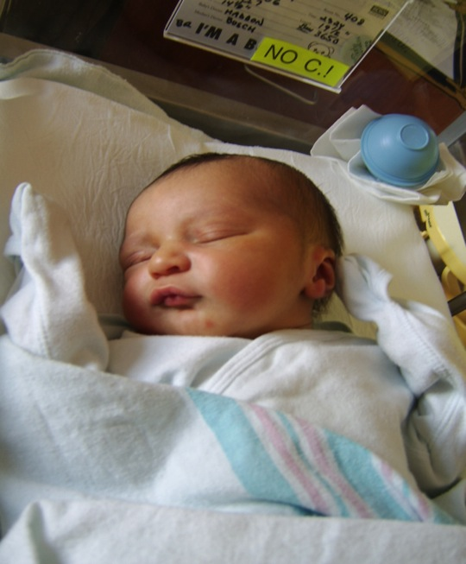
QIC-ChildRep Purpose
To gather, develop and communicate knowledge on child representation,
Promote consensus on the role of the child’s legal representative,
Sponsor Research and Demonstration projects to gain empirical evidence as to how legal representation for the child in child welfare cases might best be delivered.

Slide 7
NACC CERTIFICATION
NACC Certifies Lawyers as Specialists in Child Welfare Law.
QIC is supporting certification.
Allowing 200 lawyers per year for the next four years to receive cost waivers.
$300 vs. $600 per lawyer.

Slide 8
www.ImproveChildRep.org
On a Mission to Improve Justice for Children Through Knowledge Development and Dissemination

Slide 9
2. CURRENT STATE OF CHILD REPRESENTATION

Slide 10
Notes:
We need to be anchored in the current state of knowledge and opinion.

Slide 11
Needs Assessment 1st Year Product
Information collected on existing academic research, policy, and practice
Integrated from many sources, including state laws, journal articles, government and foundation issued reports, and State reports
In-person and phone discussions with a wide range of policy makers and practitioners.

Slide 12
NEEDS ASSESSMENT: Law on the Books
Reviewed:
State laws governing child representation.
Model Acts
Literature and Scholarship

Slide 13
NEEDS ASSESSMENT: Law in Practice
State reports
Notable Offices Site Visits
State Needs Assessment
CIP Directors
CASA
Judges
Lawyers
Caseworkers
. Focus groups at professional meetings.
Notes:
10 states, wide range of policy makers and practitioners.

Slide 14
Needs Assessment Findings - 1
Attorneys should be actively engaged with their clients in order to understand their needs and advocate effectively.
Effective representation includes a thorough investigation in order to develop a clear theory of the case and effectively advocate in court.

Slide 15
Needs Assessment Findings - 2
Attorneys effectively solve problems for their clients by engaging in active out-of-court advocacy.
Attorneys should take a holistic view of the child’s needs.
Practice in this area requires comprehensive training which includes child and family issues.

Slide 16
Needs Assessment Findings - 3
Attorneys must meet initial and ongoing qualification standards.
Supports help attorneys accomplish the multiple tasks which allow them to be successful advocates.
Caseloads must be reasonable in order for attorneys to accomplish the essential duties of their jobs.

Slide 17
QIC Best Practice Model of Child Representation
Needs Assessment led to a comprehensive QIC Best Practice Model of the current thinking about how best to represent children in the child welfare system.
See: Child Representation in America: Progress Report from the National Quality Improvement Center, 46 Fam L.Q. 1 (Spring 2012)

Slide 18
2. RESOURCES AVAILABLE NOW

Slide 19
Knowledge Development and Dissemination
Website attempts to gather all the knowledge available about child representation in child protection cases.
State laws collected in common format.
Academic research articles.
Our full Needs Assessment.
Other material helpful to states interested in improving their system of child representation.
Website: www.ImproveChildRep.org
Notes:
Audience – lawyers, policy makers, legislators and their staff, students and academics.

Slide 20
3. QIC BEST PRACTICE MODEL

Slide 21
Notes:
Teaching Sailing

Slide 22
QIC CONSISTENT WITH ABA MODEL ACT
QIC Model based on 1996 ABA Standards.
Model Act in August 2011; QIC Model in September 2010.
ABA -- Legal Framework
QIC – Clinical Skills

Slide 23
QIC Model of Child Representation
Appointment timely; protect child disrupting as little as possible; accommodate child’s wishes;
Out of Court: Meet with child, investigation, establish and maintain relationship, counsel child, pleadings, problem solver.
In-Court: Active participation, client explanation and presence, ancillary actions.

Slide 24
QIC Model of Child Representation
4. Post Hearing: Review and monitor all orders; communicate with child.
Appellate Advocacy: Yes.
6. Cessation of Representation: Thoughtfully terminate the relationship.

Slide 25
QIC Model of Child Representation: Organizational Supports
Administrative structure for appointment support and accountability. CR is independent from the court.
Lawyer Training: CR is qualified; receives on-going training and peer support.
Lawyer Compensation: Adequate and timely
Caseload Levels: Manageable size.
Notes:
Unfair to blame the individual lawyer for structural deficiencies.

Slide 26
4. RESEARCH DESIGN
Notes:
We assessed the state of knowledge and opinion, from that developed the Best Practice Model. But will that work? Will it make a difference in our children’s lives?

Slide 28
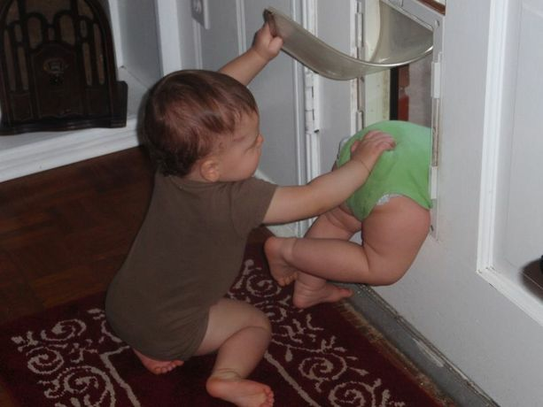
Research Partners
Chapin Hall the evaluator.
RFP - Jan 5, 2011.
GA & WA selected as partners.

Slide 29
Experimental Design
Attorneys identified.
Trained in Model.
Randomly assigned.
Cases randomly assigned.
Coaching/Fidelity.
Follow 3 years.
Notes:
Comparison Group; 125 lawyers in each state;

Slide 30
Research Questions
Do trained and coached attorneys in QIC model provide better representation than comparison?
Do QIC attorneys improve safety, permanency and well-being or otherwise change the experience of children?
What is it that makes the child lawyer more effective?
Do these answers vary by age, race, type of maltreatment, permanency type?

Slide 31
DATA GATHERING

Slide 32
Data Gathering
Data sharing agreements key:
Agency data
Court data
Attorney data
Track QIC and comparison attorneys at each step.

Slide 33
Expected Outcomes
Better Assessment of needs and desired outcomes.
Better strategic thinking to achieve those goals.
More successful advocacy.
Court cases move faster.
Lower likelihood of placement.
Reduced time in care.
More sibling placements.

Slide 34
Accommodating the Child’s Wishes - 1
To what extent did a relationship with the child help you reach decisions in this case?
Did you learn of the child’s wishes about the resolution of the case?
How much weight did you attach to the child’s wishes in this case?

Slide 35
Accommodating the Child’s Wishes - 2
To what extent did your recommendations to the court over the course of this case differ from the stated wishes of the child?
To what extent did your recommendations to the court over the course of this case differ from the recommendation of the public agency?

Slide 36
Theory of Change for Attorney Behaviors
ChildRep Demonstration Projects
Treatment
Components
Attorney Knowledge, Skills, &Attitudes
Attorney
Behaviors
Proximate Child Outcomes
Distal Child Outcomes
Increase knowledge
Child development and trauma, and their relationship to children’s capacities and needs
Increase skills
Communication and relationship-building, including interview skills
Assessment of child safety according to the QIC model
Facilitation of evaluation/assessment of needs of the child and family
Facilitation of development of an appropriate case plan
Developing active, forward-looking theory of the case
Increase understanding of importance of CR-specific tasks
Open and full communication with child clients
Building a relationship with child clients
Affording child clients opportunities to direct cases
Increase motivation to perform role of CR as represented by QIC Model
Relationship with child clients
More frequent contact with child clients
More complete disclosure to, involvement of, child clients
Better assessment of child capacity to participate in decisions
Better assessment of child safety
Engage in CR-related, out-of-court activities
Service advocacy and resource identification
Contact with children, families, and providers
Conduct thorough investigation and assessment
Vigorous advocacy
Advocacy that stresses problem-solving and non-adversarial approaches - but which include traditional adversarial modes when appropriate
Active and timely negotiation
Services
Children and families receive services that better reflect their needs and interests
E.g., more appropriate placement selection, leading to lower placement disruption and higher continuity with family and community
Court decisions more likely to reflect child’s interests
Evidence and arguments presented by attorney are more compelling
Child is empowered, has increased sense of autonomy and self-determination
Reduced time in care
Increased rate of permanency (reunification, relative, adoption exits)
No change in repeat maltreatment
No change in likelihood of reentry to care
Training in QIC Model
Ongoing coaching in QIC Model
(Note that coaching is also hypothesized to have a direct effect on attorney behaviors.)
Notes:
We expect data on 240 lawyers, with 3600 to 5000 cases. A fantastic data base. This should tell us something.

